Slide 1
Seminar 1
Content:
Arduino
Advantages
Disadvantages
How to take the best Advantages
Some important Protocols/ Communications
UART
I2C/TWI
SPI
Altium Designer
Review
Idea ??

Slide 2
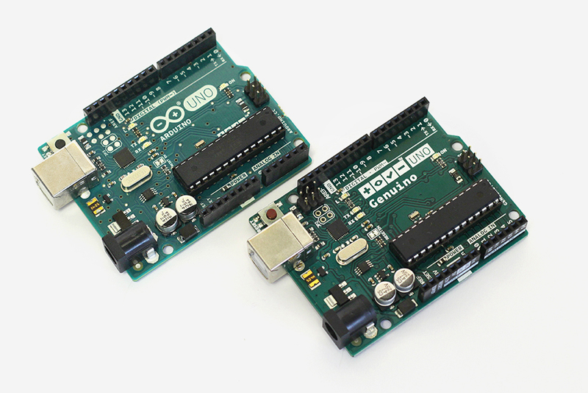
1. Arduino
“It is an open-source electronics prototyping platform based on flexible, easy to use hardware and software”

Slide 3
Advantages
Hardware side
Supports
No need create own library
USB to serial converter
No need external programmer
Cheap
Make a project quickly

Slide 4


Disadvantages
The closed library
Difficult to understand how the hardware (MCU, …) worked
Arduino’s IDE is poor
Do not have a Debugger
Wasting your microprocessor’s memory
- For example: Simple UART to write “Hello world.” on Atmega328P
Arduino
My own UART Library

Slide 5
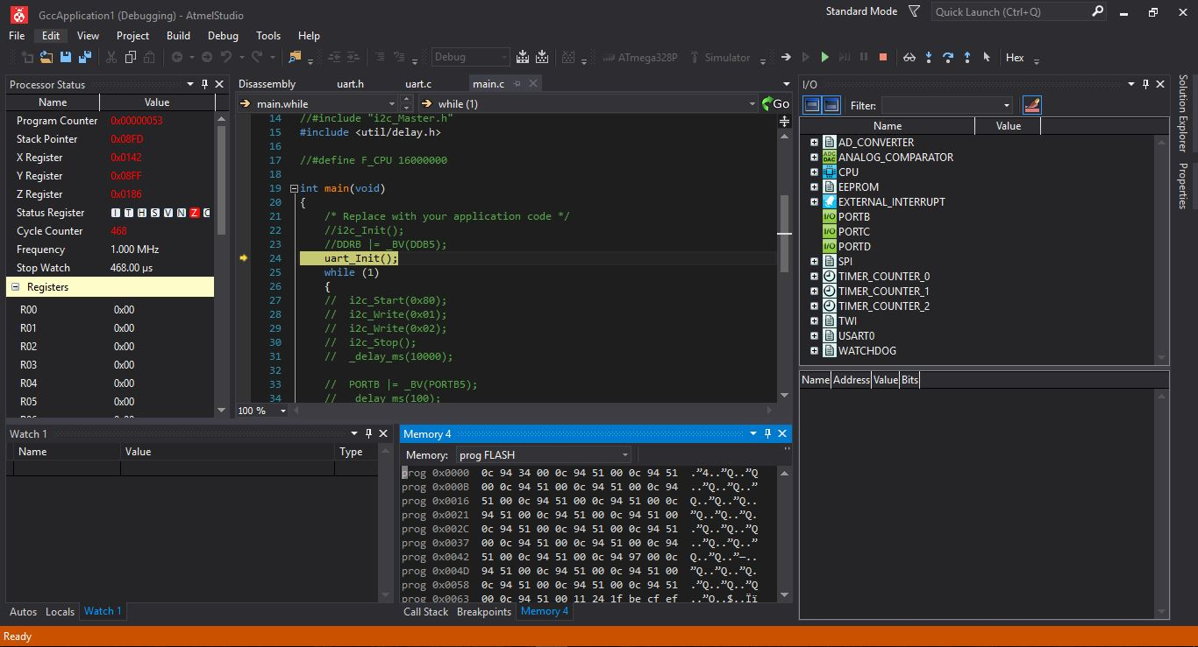
How to take the best advantage
Atmel Studio

Slide 6
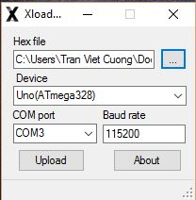

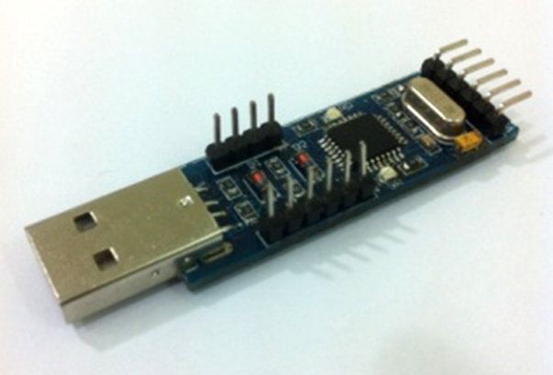
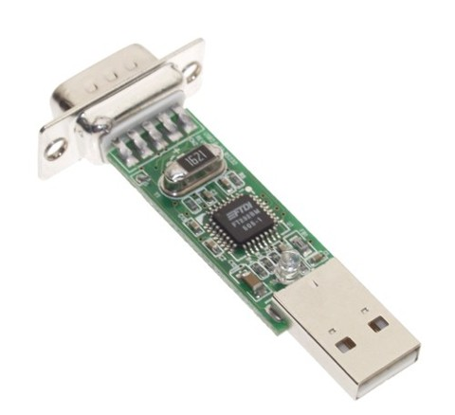
How to take the best advangtage
2. Xload for updating the hex file into Arduino

Slide 7
2. Some important Protocols/ Communications
UART
SPI
I2C/ TWI

Slide 8
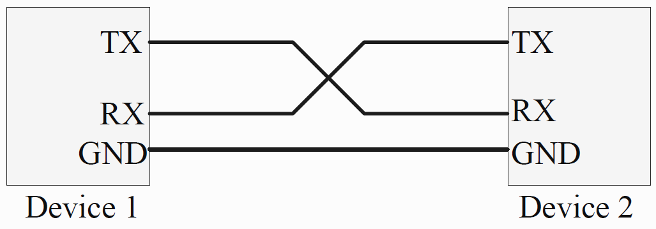
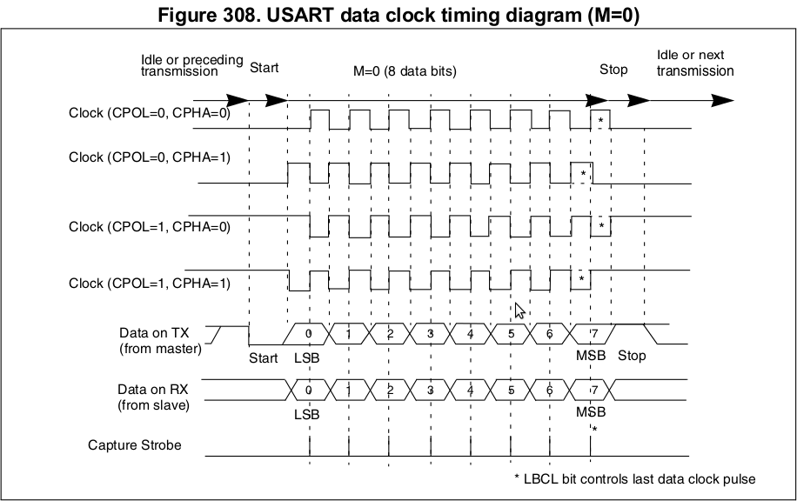
UART
- UART: Universal Asynchronuos serial Receiver and Transmitter
Baud-rate: 9600
Frame: Start bit + 8 bit Data + 1 bit Stop

Slide 9
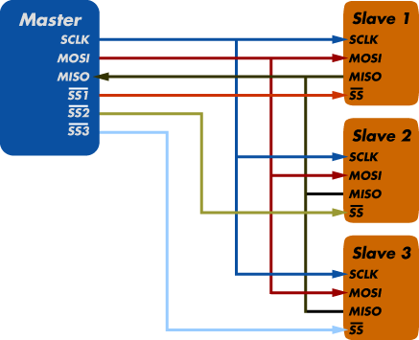
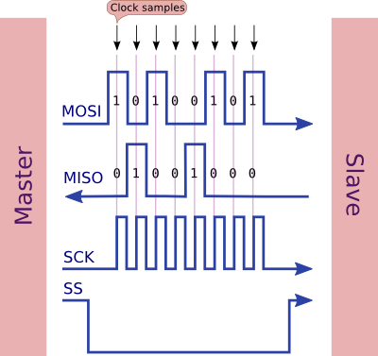
SPI
SPI (Serial Peripheral Interface)
Serial Clock
MOSI
MISO
Slave Select
Baud rate: selected by setting Reg
Frame: 8bit Data

Slide 10
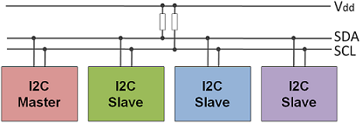
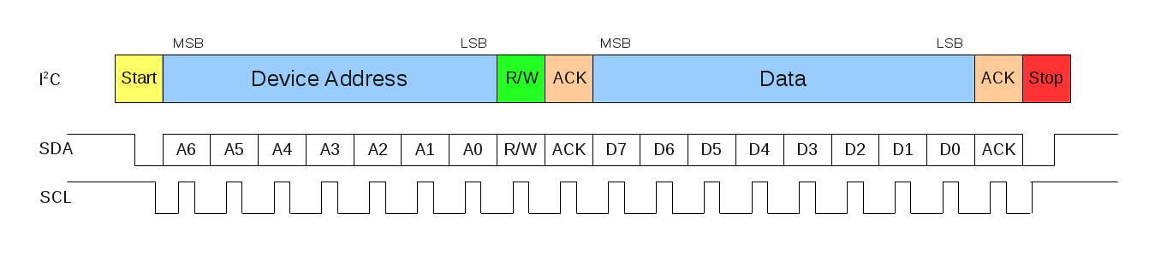
I2C/ TWI
TWI (Two-Wire serial Interface) – I2C (Inter-Integrated Circuit)

Slide 11



I2C/ TWI

Slide 12
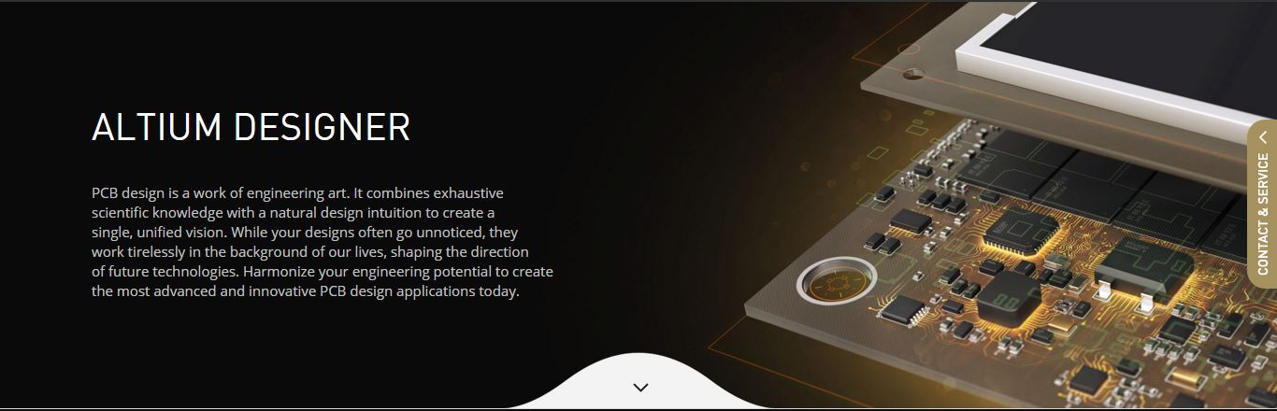
Altium Designer 16

Slide 13
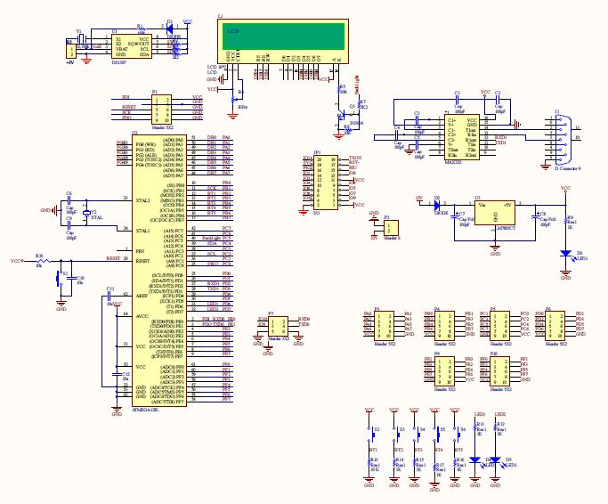
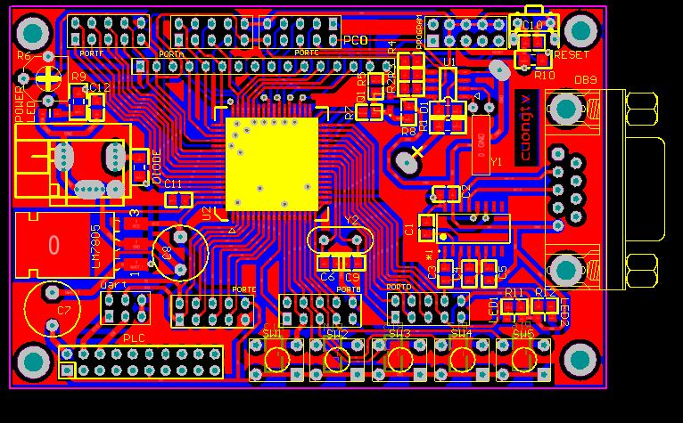
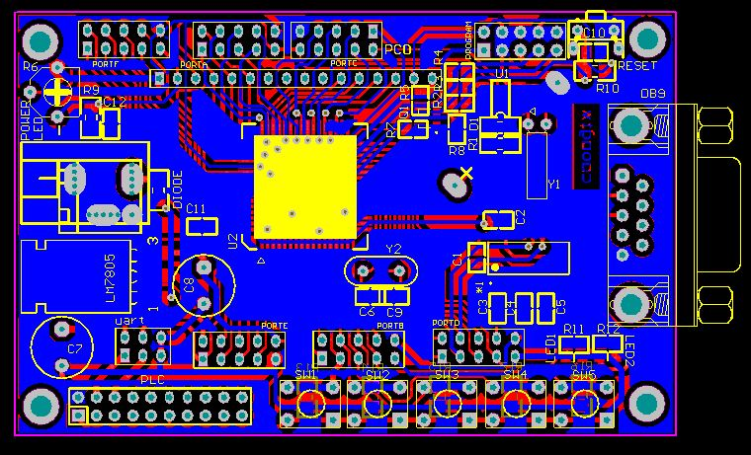
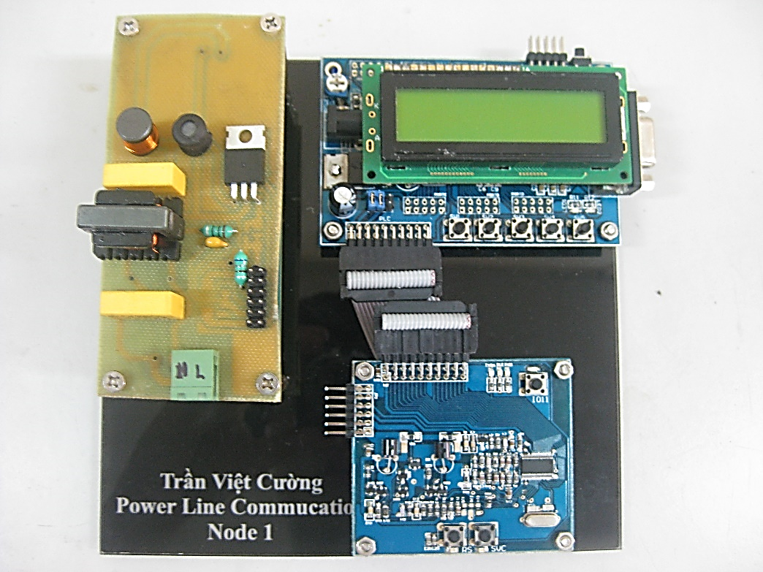
Altium Designer 16

Slide 14
Idea
Awareable System: Recognize Hand Motions (Leap Motions, Myo)
IR Camera, Camera
EMG
IMU sensor, and flex sensor.
Electrical Impedance Tomography (EIT)
Measuring heartbeat by sweating
Detecting Stress and Reducing Stress
Using google glasses to make health care system
However, the problems:
Do not have a basic knowledge about biomedical.
Not have many experiences about a range of sensors.

Slide 15
Thank you for listening

